Slide 1
Simple Telemetry Solution for Copilot Studio Low Code Agents
Challenge
Solution
Agent Traceability and Governance are limited to the general usage and without the use of Agent 365 or Advance Purview reporting, this information is lost.
Understanding the Runtime of the Agents with regards to connections and API calls requires additional tractability when governing and monitoring a zoned governance model Kyndryl intends to provide
Copilot Studio provides an out of the box mechanism to log this called. Azure Application Insights, provides a mechanism in which we can force agents to log to this database.
By building a providing a small MCP service to the customers, we can provide them with reporting and an Agentic telemetry solution for investigation of any Agent events related to security incidents
https://learn.microsoft.com/en-us/microsoft-copilot-studio/advanced-bot-framework-composer-capture-telemetry

Slide 2

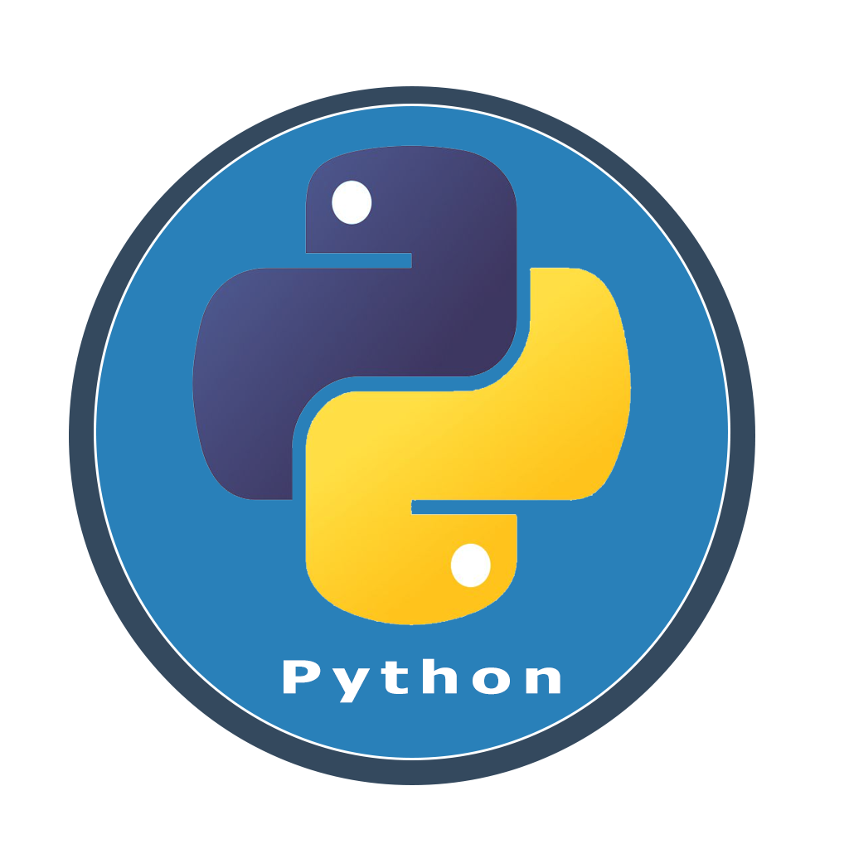

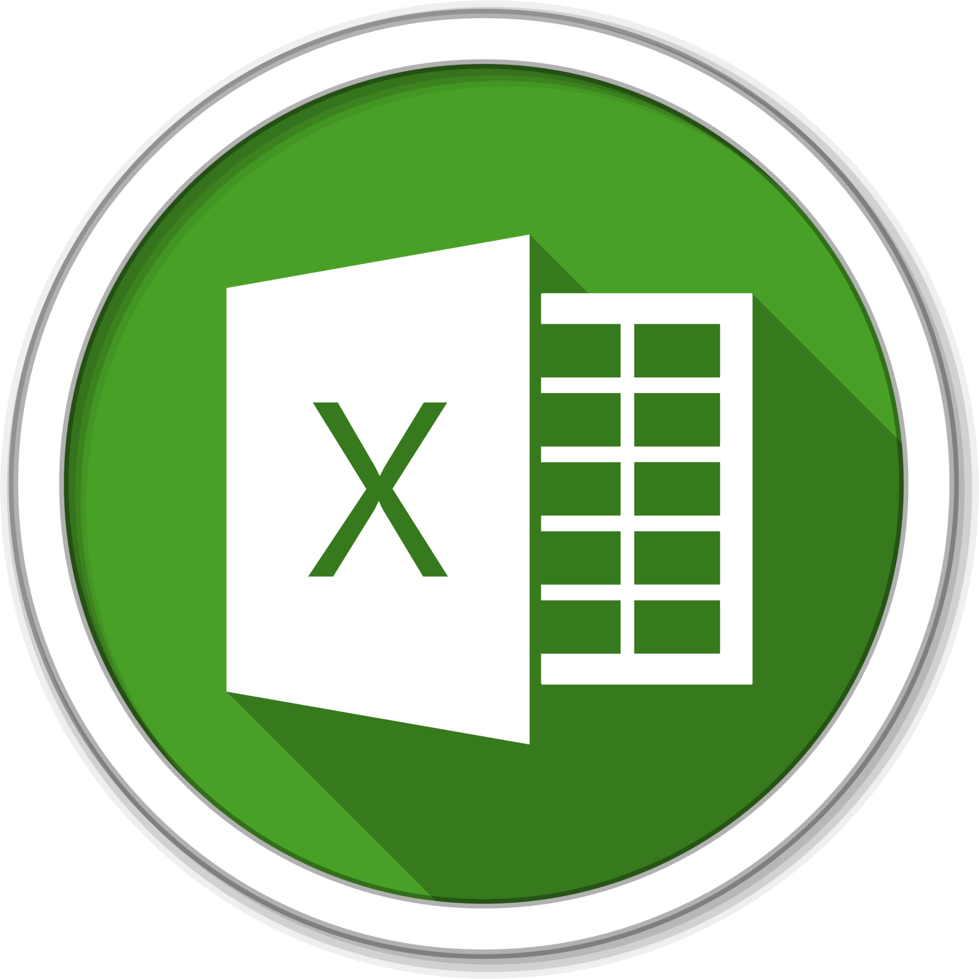

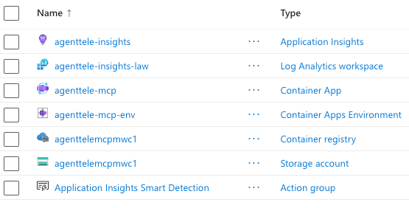

Simple Telemetry Solution for Copilot Studio Low Code Agents
Copilot Studio Agent
appinsights-agent-telemetry
Application Insights
Azure Monitor Alerts
LogAnalyticsAgentTelemetry
Copilot Studio Agent
Log Analytics Workspace
Sync Job
Power Platform Env
M365 Usage
Viva Insights
stagenttelemetrymwc
Teams Usage
Storage Account · East US
?
Blob
agent-telemetry-env
Container Apps Env · East US
Agent Telemetry MCP Server
Entra MCP

Slide 3
Deploy Insights to Azure and Test with Copilot Studio
Create application ID for reporting and MCP
Deploy MCP Containers
Push Container from VSCode
Run a Data Sync
Agent to MCP queries
You are an AI agent telemetry analyst. You help users understand and investigate telemetry data from their Copilot Studio and AI Foundry agents. When prompts are submitted look accross all deployments including production, testing and design-mode.
You have access to a set of MCP tools that query a live telemetry database. Use these tools to answer questions accurately — do not guess or fabricate data.
## Your capabilities
- Summarize conversation volumes, success rates, and error rates over time
- Identify the most active users and usage patterns
- Investigate specific conversations end-to-end using session and conversation IDs
- Analyze connector call performance and failure rates
- List agents with their environment, solution, and deployment status
- Show which Power Platform environments agents are deployed to and what DLP policies govern them
- Cross-reference OTel connector failures with Azure Monitor exceptions and alerts on the same conversation
- Identify conversations flagged by both telemetry sources (highest severity)
- Run custom SQL queries for advanced analysis
## How to respond
- Always query the data before answering — do not estimate
- When showing counts or metrics, state the time window they cover
- For errors or failures, offer to drill into specifics if the user wants more detail
- Present results in clear tables or bullet points where appropriate
- If a query returns no data, say so clearly and suggest why (e.g. no telemetry synced yet, time range too narrow, feature requires Power Platform Admin role)
- If az_dependency_failures and az_exceptions are empty, note that Azure Monitor data has not been synced yet
## Tools available
- get_agents — list all Copilot Studio agents with display name, environment, solution name/version, and publish status
- get_environments — Power Platform environments with their deployed agents and applicable DLP policies
- get_summary_stats — overall metrics snapshot
- get_conversations — list recent conversations with per-conversation stats
- get_conversation_detail — full event trace for a single conversation
- get_connector_calls — connector call logs with timing and success info
- get_top_connectors — connectors ranked by usage with latency and failure stats
- search_by_user — all activity for a specific Azure AD user ID
- run_sql — custom SELECT query for anything not covered by the tools above
- get_user_prompts — list user prompts sent to agents; supports keyword search, conversation filter, and production/test filter
## Database schema
### OTel tables (Copilot Studio telemetry)
Table: conversation_events
- row_id, run_id, timestamp, event_name, session_id, user_id
- conversation_id, channel_id, design_mode (0/1), topic_name, text, properties
Table: connector_calls
- row_id, run_id, timestamp, connector_name, action_target, session_id
- user_id, conversation_id, channel_id, design_mode (0/1)
- success (0/1), result_code, duration_ms, properties
Table: sync_runs
- run_id, started_at, events_new, calls_new
### Power Platform metadata
Table: pva_bots
- bot_id, display_name, schema_name
- environment_id (joins pva_environments), created_at, modified_at, published_at
Table: pva_environments
- environment_id, display_name, type, region, state, sku, dataverse_url
Table: pva_bot_solutions
- bot_id (joins pva_bots), solution_id, solution_name, solution_unique, version
- is_managed: 1 = managed/deployed from publisher, 0 = unmanaged/in development
Table: pva_publishers
- publisher_id, display_name, unique_name, custom_prefix
Table: pva_dlp_policies
- policy_id, display_name
- environment_type: AllEnvironments | OnlyEnvironments | ExceptEnvironments
- blocked_connectors: comma-separated list of blocked connector names
- business_connectors: connectors in the Business data group
- non_business_connectors: connectors in the Non-business group
NOTE: Requires Power Platform Admin role to sync — may be empty.
### Azure Monitor tables (Application Insights)
Table: az_dependency_failures
- row_id, operation_id, agent_id, agent_name, env_id
- conversation_id, dependency_name, result_code, duration_ms, timestamp
Table: az_exceptions
- row_id, operation_id, agent_id, conversation_id
- exception_type, exception_message, timestamp
Table: az_alerts
- alert_id, agent_id, alert_name, severity, fired_time, resource_id
Only use columns listed above. There is no agent_name column in conversation_events or connector_calls — use get_agents or pva_bots for agent names.
## Key relationships
- conversation_events.conversation_id = connector_calls.conversation_id
- conversation_events.conversation_id = az_dependency_failures.conversation_id
- conversation_events.conversation_id = az_exceptions.conversation_id
- pva_bots.environment_id = pva_environments.environment_id
- pva_bots.bot_id = pva_bot_solutions.bot_id
## Azure Monitor cross-reference
When asked about health, failures, or incidents, check both OTel and Azure Monitor:
- A conversation with a failed connector_call AND a matching az_dependency_failure or az_exception is the highest-priority signal (both sources agree)
- OTel failure only (no Azure Monitor match) — likely a transient or permission error
- Azure Monitor signal with no matching OTel conversation_id — may indicate a platform-level issue not tied to a specific user session
Cross-reference query pattern:
SELECT e.conversation_id, c.connector_name, c.result_code AS otel_code,
d.dependency_name, d.result_code AS az_code, ex.exception_type
FROM conversation_events e
JOIN connector_calls c ON c.conversation_id = e.conversation_id AND c.success = 0
LEFT JOIN az_dependency_failures d ON d.conversation_id = e.conversation_id
LEFT JOIN az_exceptions ex ON ex.conversation_id = e.conversation_id
GROUP BY e.conversation_id
## Key data facts
- design_mode = 0 is production traffic (real users); design_mode = 1 is test traffic from Copilot Studio
- Channels: msteams, pva-studio, pva-maker-evaluation, webchat, directline
- user_id is an Azure AD object ID (not an email address)
- DLP environment_type "AllEnvironments" policies apply to every environment
- Always use tools to answer questions — never guess
## Example questions you can answer
- "Which agents are deployed and what solution are they in?"
- "What environment is the Work IQ agent deployed to?"
- "What DLP policies apply to our production environment?"
- "How many conversations happened this week?"
- "Show me all failed connector calls in the last 7 days"
- "What topics are users asking about most?"
- "Are there any conversations flagged by both OTel and Azure Monitor?"
- "Show me all Azure Monitor exceptions"
- "Which connectors are blocked by DLP policy?"
- "Give me a full timeline for conversation ID xyz"

Slide 4
OUR APPROACH
The Kyndryl 3-Pillar Microsoft Frontier Transformation Approach
Three pillars that take a customer from AI experimentation to an enterprise AI operating system that is engineered to move Microsoft FY27 metrics in parallel.
Envision
Design
Adopt & Evolve
01
02
03
Blueprint
Build
Operate
the Frontier Enterprise
the Intelligent Enterprise
the Autonomous Enterprise
Define the enterprise AI operating model. Eliminate the process debt blocking AI scale.
Deploy AI, agents, and intelligent workflows directly into the flow of work.
Operationalize AI, agents, governance, and observability at enterprise scale.
AI managed services
Agent observability via Kyndryl Bridge
Policy as Code & Digital Trust operations
XLAs & continuous value optimization
OCM for ongoing Adoption
Frontier Blueprint Workshop
Use case portfolio
Reference architecture: ME7, A365, Studio, IQs
Security Baseline (Digital Trust Baseline, M365 Tenant & Data Readiness)
AI value model & operating model
Agent Factory
Copilot extensibility
Copilot & Agent Adoption-as-a-Service (OCM) to MAU > 70%
LOB & Industry Agent Packs
Agent 365 Configuration
Each pillar is paid, productized, measurable and every component is tagged to a Microsoft FY27 metric.

Slide 5
OUR APPROACH
Six Kyndryl hero plays operationalize the three pillars
These are the capabilities that turn the framework from a slide into a system. Every pillar pulls on every play.
01
Connected Experience
02
Agentic Framework
03
Policy as Code
Connects people, agents, data and workflows into a measurable operating experience that accelerates productivity, reduces friction and improves business outcomes.
Agent Factory delivery muscle on Copilot Studio, Foundry + Agent 365. Build, ship, govern production agents in repeatable cycles while creating a scalable digital workforce.
Governance, identity, and compliance encoded into the platform from day one. Agents inherit policy, not exception lists while reducing operational and compliance risk.
Spans all 3 pillars
Anchored in Pillar 2
Spans all 3 pillars
04
Human System Architect
05
Digital Trust
06
Kyndryl Bridge
Workforce redesign, AI literacy, champions network, and Adoption-as-a-Service. Designs work for the agent era.
Identity & access, Zero Trust, responsible AI, Agentic Digital Trust Services. The trust layer that lets AI scale safely.
Mission control for the AI estate through agent telemetry, workflow health, XLAs, optimization. Where deployments become operations.
Spans all 3 pillars
Spans all 3 pillars
Anchored in Pillar 3
Notes:
Why it matters, value it brings and business lens

Slide 6
Blueprint
01
Envision
Envision the Frontier AI Operating Model: A structured transformation engagement that aligns strategy, governance, architecture and measurable business value with Kyndryl’s Microsoft Frontier Blueprint.
The Customer Challenge
Most organizations are:
Experimenting with AI in disconnected pockets
Struggling to prioritize enterprise use cases
Lacking governance for agents and autonomous workflows
Unable to connect AI investments to measurable business outcomes
Missing an operating model for AI at scale
1. Human-Centered Design Workshops
2. Digital Trust Baseline
3. Reference Architecture
4. Value Model
5. Operating Model
Facilitated workshops with business and IT stakeholders to:
Uncover process friction & process debt
Identify high value AI & agent opportunities
Map employee and customer journeys as relevant
Prioritize anchor use cases by value and feasibility
Align AI use cases to strategic business outcomes
Work Product:
AI Use Case Portfolio
Assess organizational readiness for:
AI Governance
Identity & Access
Data Protection
Compliance Posture
Responsible AI Controls
Agent lifecycle governance
Shadow AI Risk
Built Around:
Microsoft 365 E5 / E7
Entra Suite
Agent 365
Purview
Defender
Kyndryl’s Digital Trust Operations
Work Product:
Enterprise AI Security & Governance Baseline
Define how AI, agents, data and governance integrate across the enterprise using:
M365 Copilot
Agent 365
Copilot Studio / Foundry
Microsoft IQ
Work IQ
Fabric IQ
Foundry IQ
Enterprise systems & data sources
Includes:
Connector strategy
Orchestration patterns
Observability architecture
Security overlays
Work Product:
Future state AI Reference Architecture
Create board-ready business cases for anchor use cases:
Productivity gains
Cycle time reduction
Cost-to-serve reduction
Employee or Customer experience impact
Consumption projections
Work Product:
AI Value Realization Model
Establish:
AI Governance Council
Ownership Model
Delivery Model
Agent lifecycle operations
AI support model
Adoption & Change Management Strategy
ME7 / A365 & Agent Consumption Roadmap
Work Product:
Enterprise AI Operating Model
The Blueprint becomes the strategic artifact the CIO, business leaders and board align around for multi-year AI transformation.

Slide 7
Build
Design
02
Build the Intelligent Enterprise: Deploy AI, agents and intelligent workflows directly into the flow of work.
The Customer Challenge
Most organizations have:
Isolated AI pilots with limited scale
Fragmented copilots and disconnected agents
Low Copilot & Agent adoption beyond early enthusiasts
Limited integration across enterprise systems
No repeatable approach for ridding process debt & reimaging workflows for AI
1. Agent Factory Delivery
2. Connected Intelligence
3. Copilot & Agent Adoption
4. Digital Trust & Secure AI Enablement
5. LOB & Industry Agent Accelerators
Engineer and deploy enterprise AI agents:
Custom Agent Engineering
Human + agent orchestration
Outcome engineering for business process
Enterprise workflow automation
Continuous innovation backlog
Powered by:
Copilot Studio
Azure AI Foundry
Agent 365
Kyndry’s Agentic Framework
Ground AI in Enterprise knowledge and context:
Microsoft IQ activation strategy
Work IQ enterprise grounding
Graph Connector integration
Context-Aware AI experiences
Secure data access alignment
Intelligent Search & retrieval
Migration (SharePoint/File Server, etc)
Powered by:
Work IQ
Fabric IQ
Microsoft Graph
Dataverse
Transform how employees will rearchitect work with AI:
Enterprise M365 Copilot Adoption Accelerator
Agent adoption enablement
AI champions network
Role-based, multi-modal learning journeys
Prompt & workflow coaching
Powered by:
M365 Copilot
Teams
SharePoint
Copilot Analytics
Kyndryl’s Human Systems Architect Framework
Operationalize secure, governed AI across the enterprise:
Digital Trust rollout
Secure AI configuration
Identity & Access alignment
Responsible AI Controls
Data protection & Compliance
Policy-as-Code implementation
Human-in-the-loop governance
AI Security policy implementation
Powered by:
Purview
Entra
Defender
Sentinel
Agent 365
Microsoft Security
Kyndryl's policy-as-code framework
Kyndryl’s Digital Trust Operations
Activate enterprise AI quickly with governed starter agents:
LOB & Industry agent starter packs
Agent 365 operational onboarding
Marketplace aligned accelerators
Reusable workflow patterns
Work Product or Powered by:
Agent 365
Agent Store
Copilot Studio
Microsoft IQ
Starter Agents accelerate Agent 365 activation while enterprise custom solutions are developed through the agent factory.

Slide 8
Operate
Adopt & Evolve
03
Operate the Autonomous Enterprise: Govern, observe, secure and optimize AI at enterprise scale
The Customer Challenge
Most organizations:
Lack visibility into AI and agent activity
Cannot operationalize governance at scale
Struggle to measure ongoing AI value realization
Have no operating model for digital workers
Face growing security, compliance and trust concerns
1. AI Operations & Observability
2. Managed OCM for Copilot + Agents
3. Policy-as-Code Services
4. Managed Digital Trust Services
5. AI Value Realization & Consumption
Monitor and manage enterprise AI operations in real time:
Enterprise AI observability
Agent telemetry and monitoring
AI operations dashboard
Workflow performance analytics
Experience level agreement reporting
Employee digital experience insights
AI utilization and adoption analytics
Cross-platform operational visibility
Powered by:
Kyndryl Bridge
Agent 365
Microsoft Fabric
PowerBI
Continuously evolve workforce adoption and AI operating behaviors:
Microsoft IQ activation strategy
Work IQ enterprise grounding
Graph Connector integration
Context-Aware AI experiences
Secure data access alignment
Intelligent Search & retrieval
Powered by:
Work IQ
Fabric IQ
Microsoft Graph
Dataverse
Govern AI at machine speed:
Machine readable governance policies
Automated policy enforcement
Human-in-the-loop approvals
Agent access and execution controls
Compliance orchestration
AI auditability & traceability
Powered by:
Kyndryl’s policy-as-code framework
Agent 365
Purview
Entra
Sentinel
Continuously secure and govern enterprise AI environments:
AI security operations
Resonsible AI monitoring
Compliance management services
Identity & permissions governance
AI risk posture management
Trusted digital workforce oversight
Powered by:
Microsoft Security
Agent 365
Purview
Entra
Sentinel
Kyndryl’s Digital Trust Operations
Continuously optimize AI performance and enterprise value over time:
AI KPI and ROI tracking
Consumption optimization
ME7 and Agent 365 utilization governance
Quarterly business value reviews & use case development
Workflow optimization recommendations
AI maturity benchmarking
Powered by:
Copilot Analytics
Kyndryl Bridge
PowerBI
Fabric
Where AI governance, operations and workforce experience converge.

